Slide 1
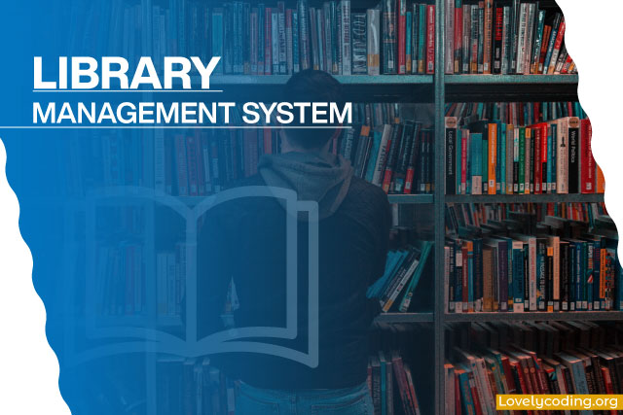

GIDED BY :
MR. BHABANI SANKAR SAHU
Presented by :
SANKAR CHAITAN JENA
SANTOSHINI SAHOO
BHUMIKA SINGH
ASHISH BEHERA
SMITAPRANGYA PATTANAYAK
SOUMYA RANJAN ROUT
August
2022

Slide 2
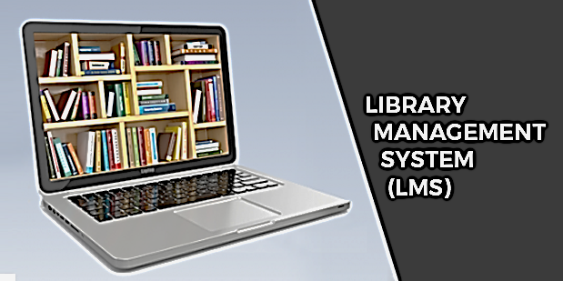
CONTENT :
1. Introduction about project
2. Objective of the project
3. Hardware and Software requirements
4. About C
5. Flowchart
6. Source Code
7. Output
8. Conclusion

Slide 3

INTRODUCTION ABOUT THE PROJECT :
A library management system is software that is designed to manage all the functions of a library. It helps librarian to maintain the database of new books and the books that are borrowed by members along with their due dates.
This system completely automates all your library’s activities. The best way to maintain, organize, and handle countless books systematically is to implement a library management system software.
A library management system is used to maintain library records. It tracks the records of the number of books in the library, how many books are issued, or how many books have been returned or renewed or late fine charges, etc.
You can find books in an instant, issue/reissue books quickly, and manage all the data efficiently and orderly using this system. The purpose of a library management system is to provide instant and accurate data regarding any type of book, thereby saving a lot of time and effort.

Slide 4

OBJECTIVE OF THE PROJECT :
The main objective of the Library Management System is to manage the details of Address, Member, Issues, Books, Student. It manages all the information about Address, Librarian, Student.
The purpose of the project is to build an application program to reduce the manual work for managing the Book address, Member, Librarian and Issues.
It tracks all the details about the Issues ,Books, Students.
Features of Our Library Management System :
Add Books
Issue Books
View Books
Delete Books
Student Issues Books Records
Student Submit Books

Slide 5
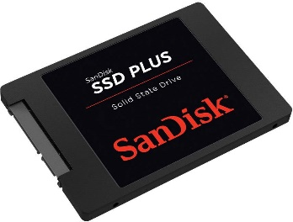
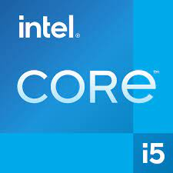
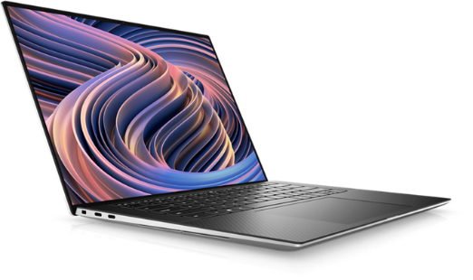

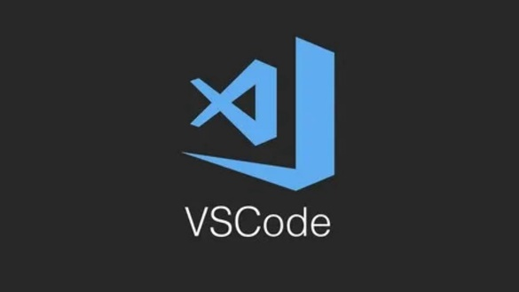
HARDWARE AND SOFTWARE REQUIREMENTS :
Hardware :
Operating system : Window 11
SSD : 512GB
RAM : Minimum Requirement
Processer : CORE i5
Software :
Programming language : C Language
IDE : VS Code (Visual Studio Code)
Compiler : GCC (GNU Compiler Collection)

Slide 6

ABOUT C :
Dennis Ritchie is known as the founder of the c language.
C programming language was developed in 1972 by Dennis Ritchie at bell laboratories of AT&T (American Telephone & Telegraph), located in the U.S.A.
C programming is considered the base for other programming languages, that is why it is known as the mother language.
C is one of the fastest programming language as it is close to low-level languages such as Assembly language.

Slide 7
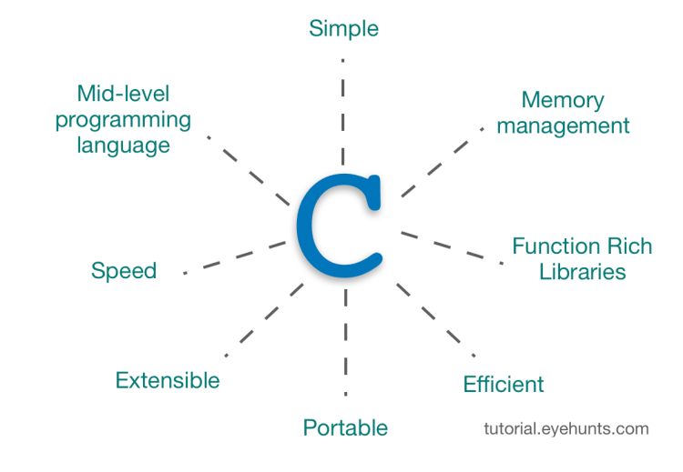
Features of C Language :
Simple
Machine Independent or Portable
Mid-level programming language
structured programming language
Rich Library
Memory Management
Fast Speed
Pointers
Recursion
Extensible

Slide 8
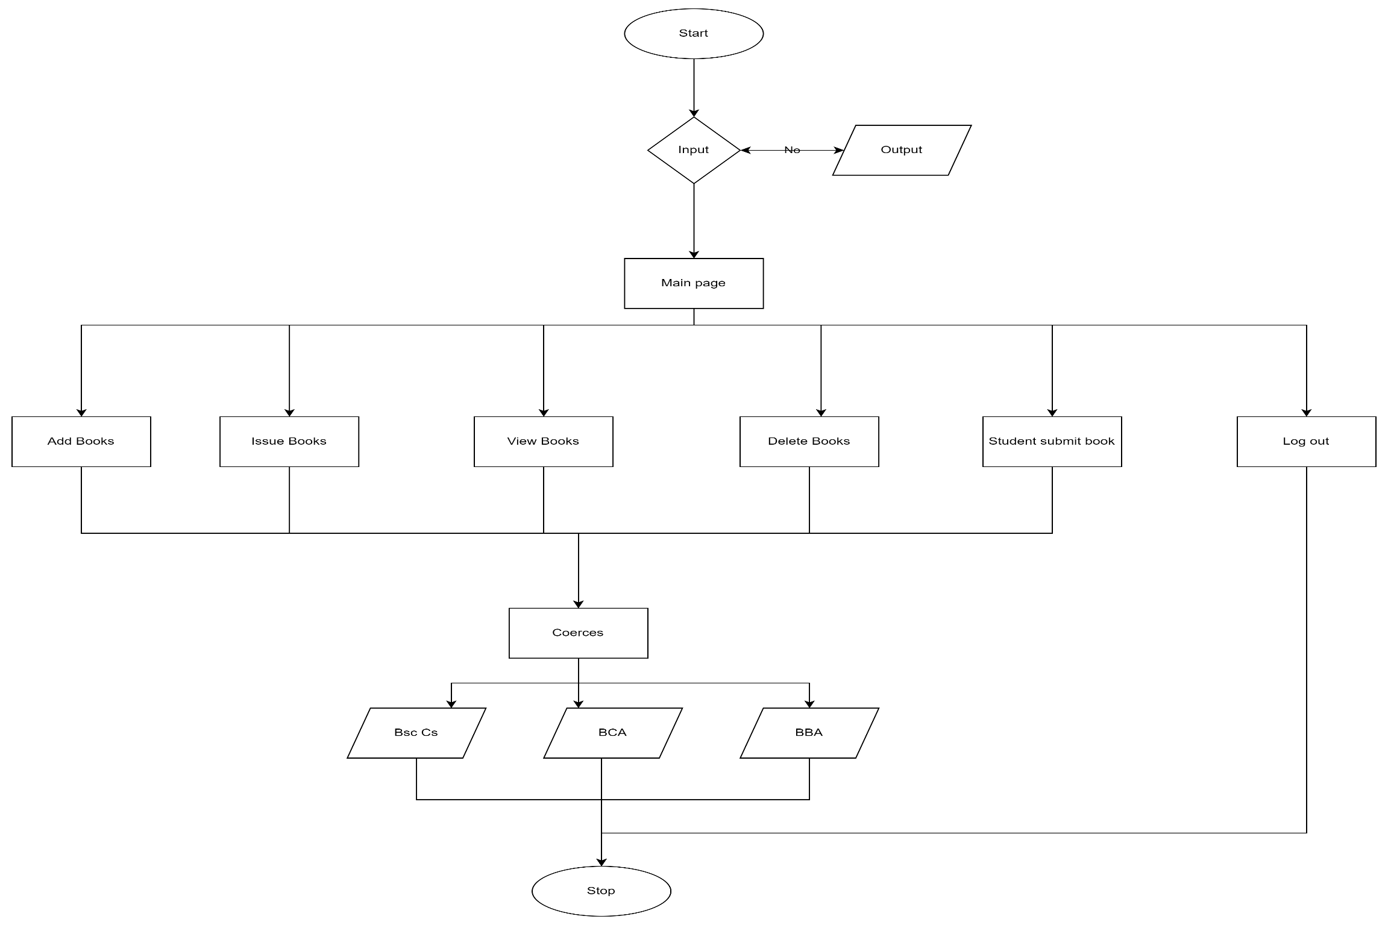
Flowchart :
Regestation
yes

Slide 9
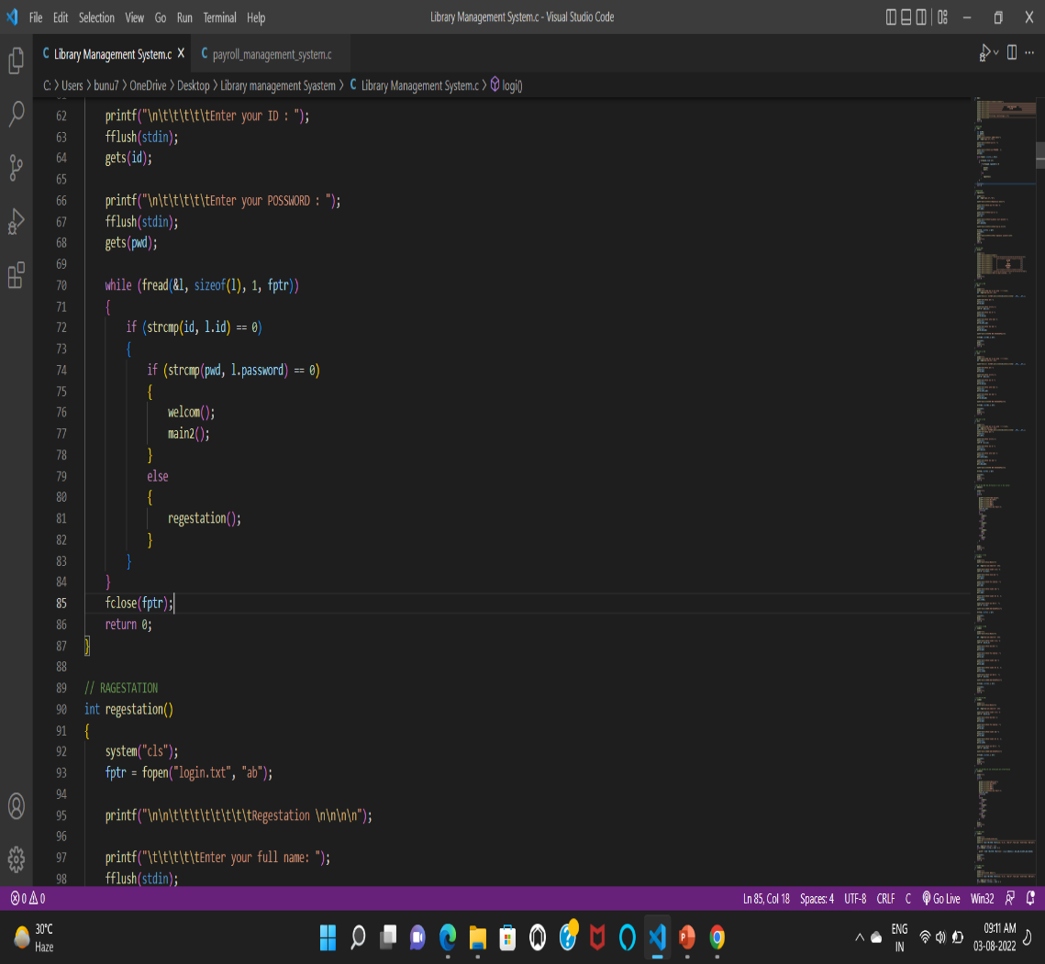
SOURCE CODE:
Functions use in this project:-
head() :- This Function used for print user 1st welcome part.
logi():- This Function used for login.
regestation():- This Function used for registration.
welcom():- This Function used after login welcome part
bba():- This Function used for add bba book .
bca():- This Function used for add bca books.
bsc():- This Function used for add bsc books.
addbooks():- This Function used for adding all bba, bca & bsc books, and options.
issubsc() , issubca(), issubba():-These three function are use issu books bsc ,bba, bca student.
issubook():- This Function used for issue all books bba, bca & bsc books, and options.
int viewbsc(), int viewbca() , int viewbba():-These three function are use view books bsc ,bba, bca student.

Slide 10
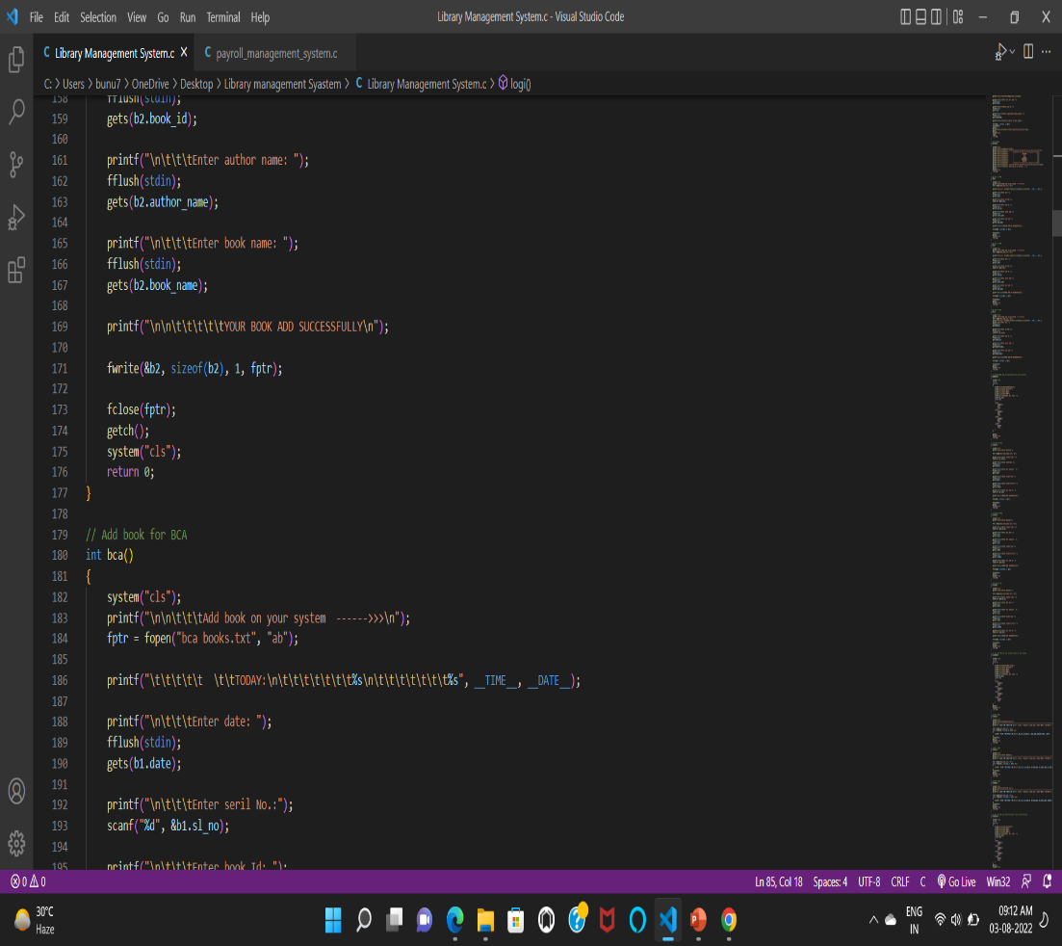
12. viewbook() :- All bba, bca, bsc books are view in this function.
13. dltbsc(), dltbca(), dltbba(), dlt() :- Delete books in this function.
14. bscrec(), bcarec(), bbarec(),bookrecord() :- All BSc, BCA ,BBA issu books function are call in this function.
15. bscissudlt(), bcaissudlt(), bbaissudlt(), dlt_issu_book():- All BSc, BCA ,BBA issu books delete function are call in this function

Slide 11
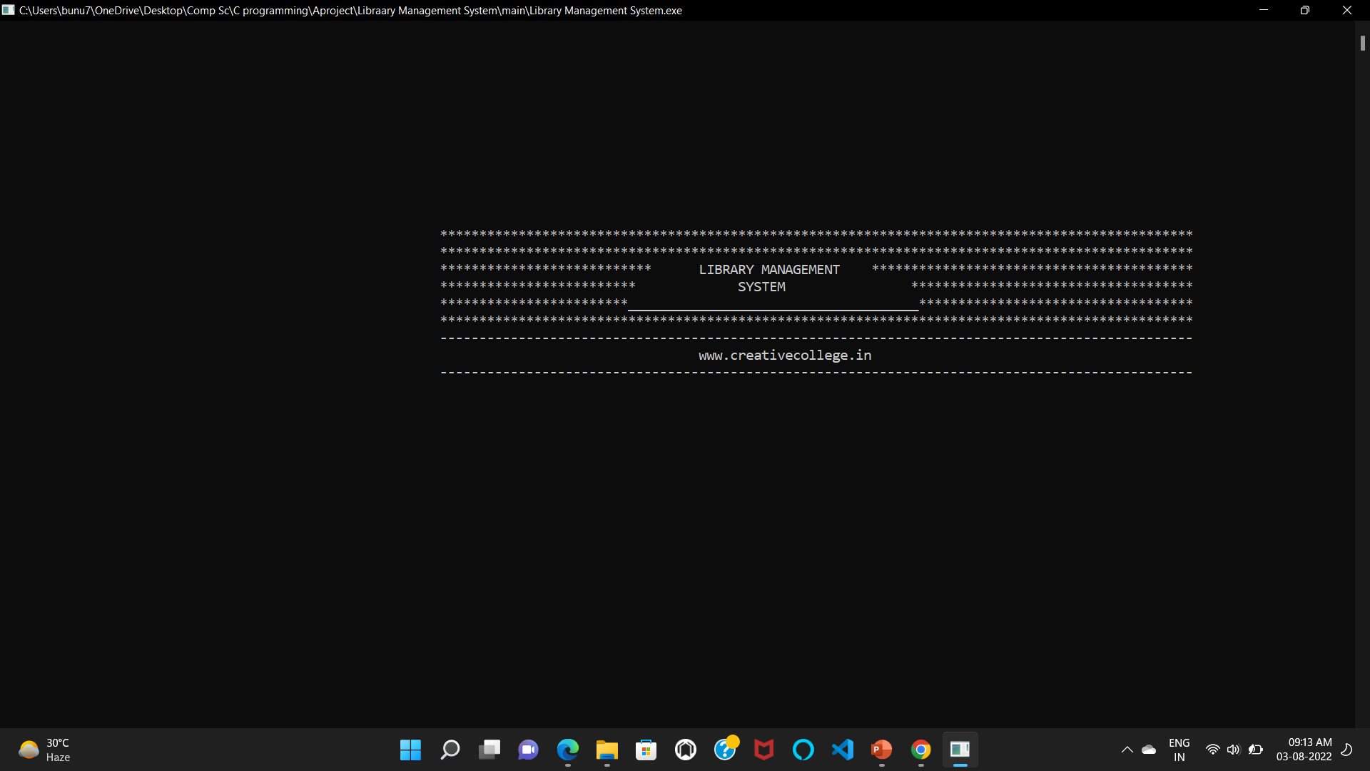
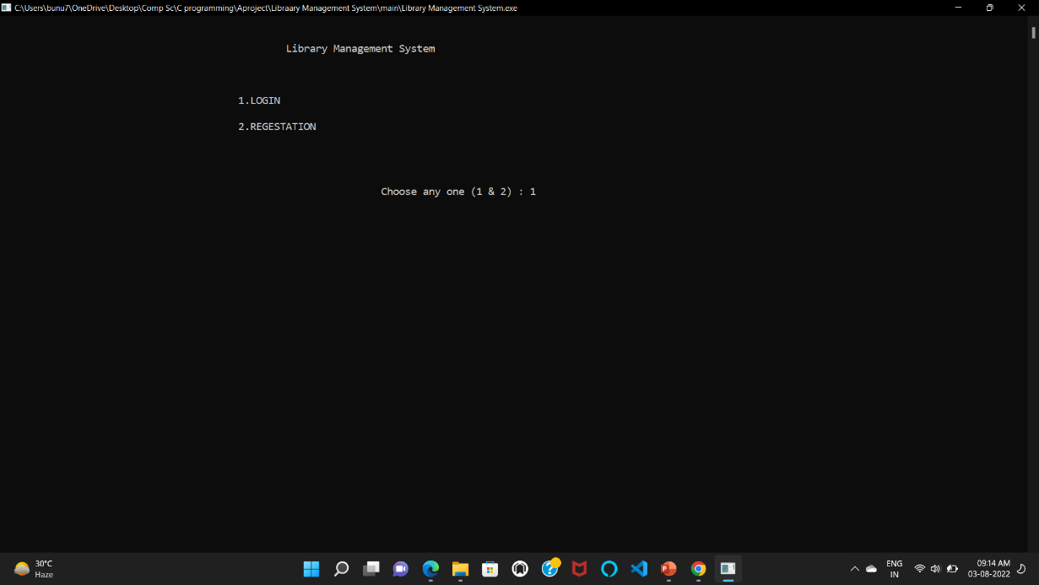
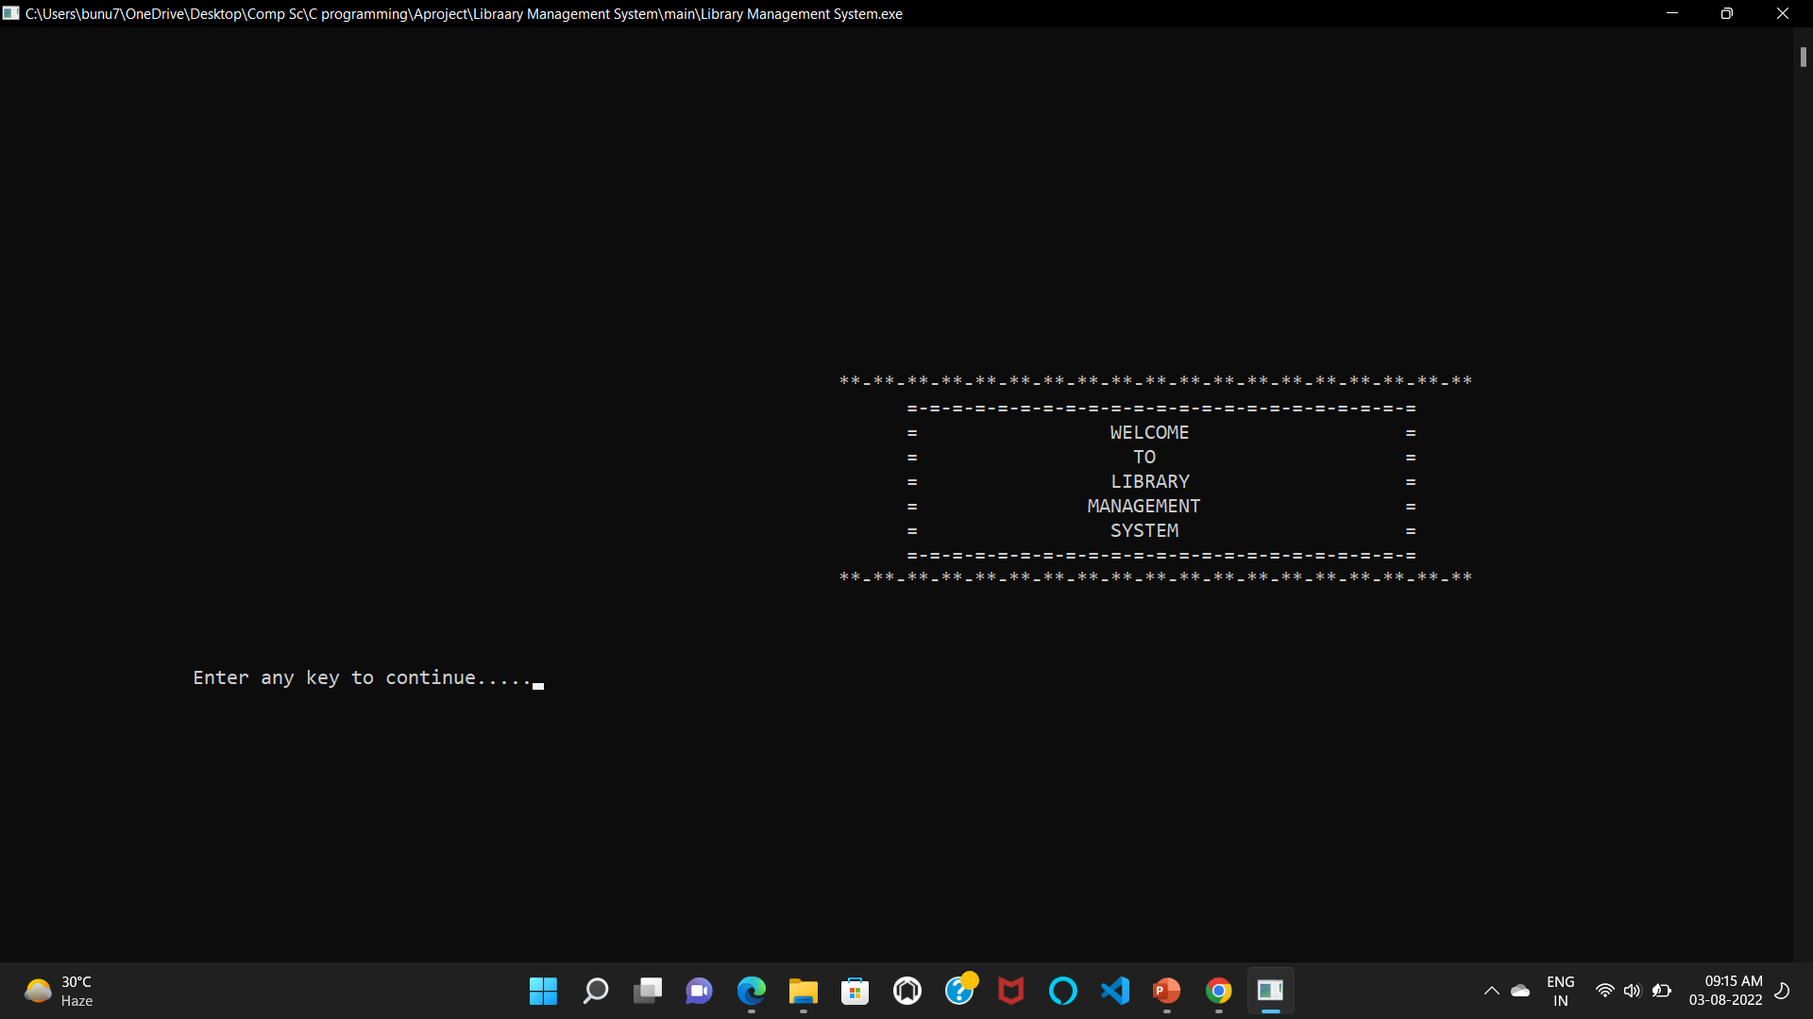
OUTPUT :

Slide 12
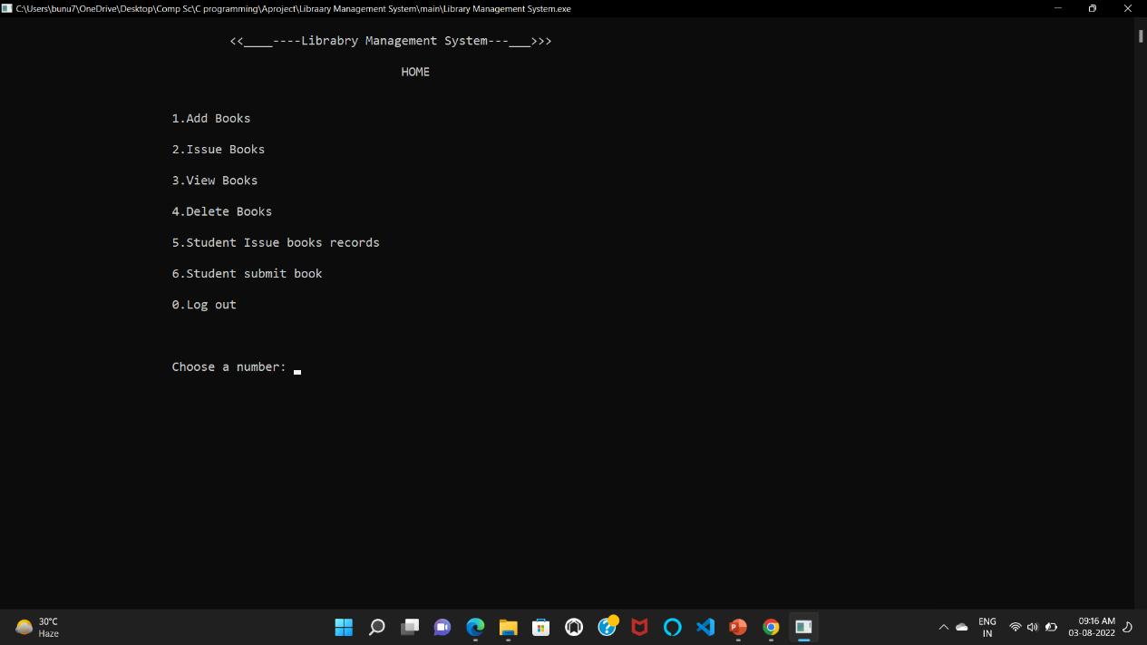
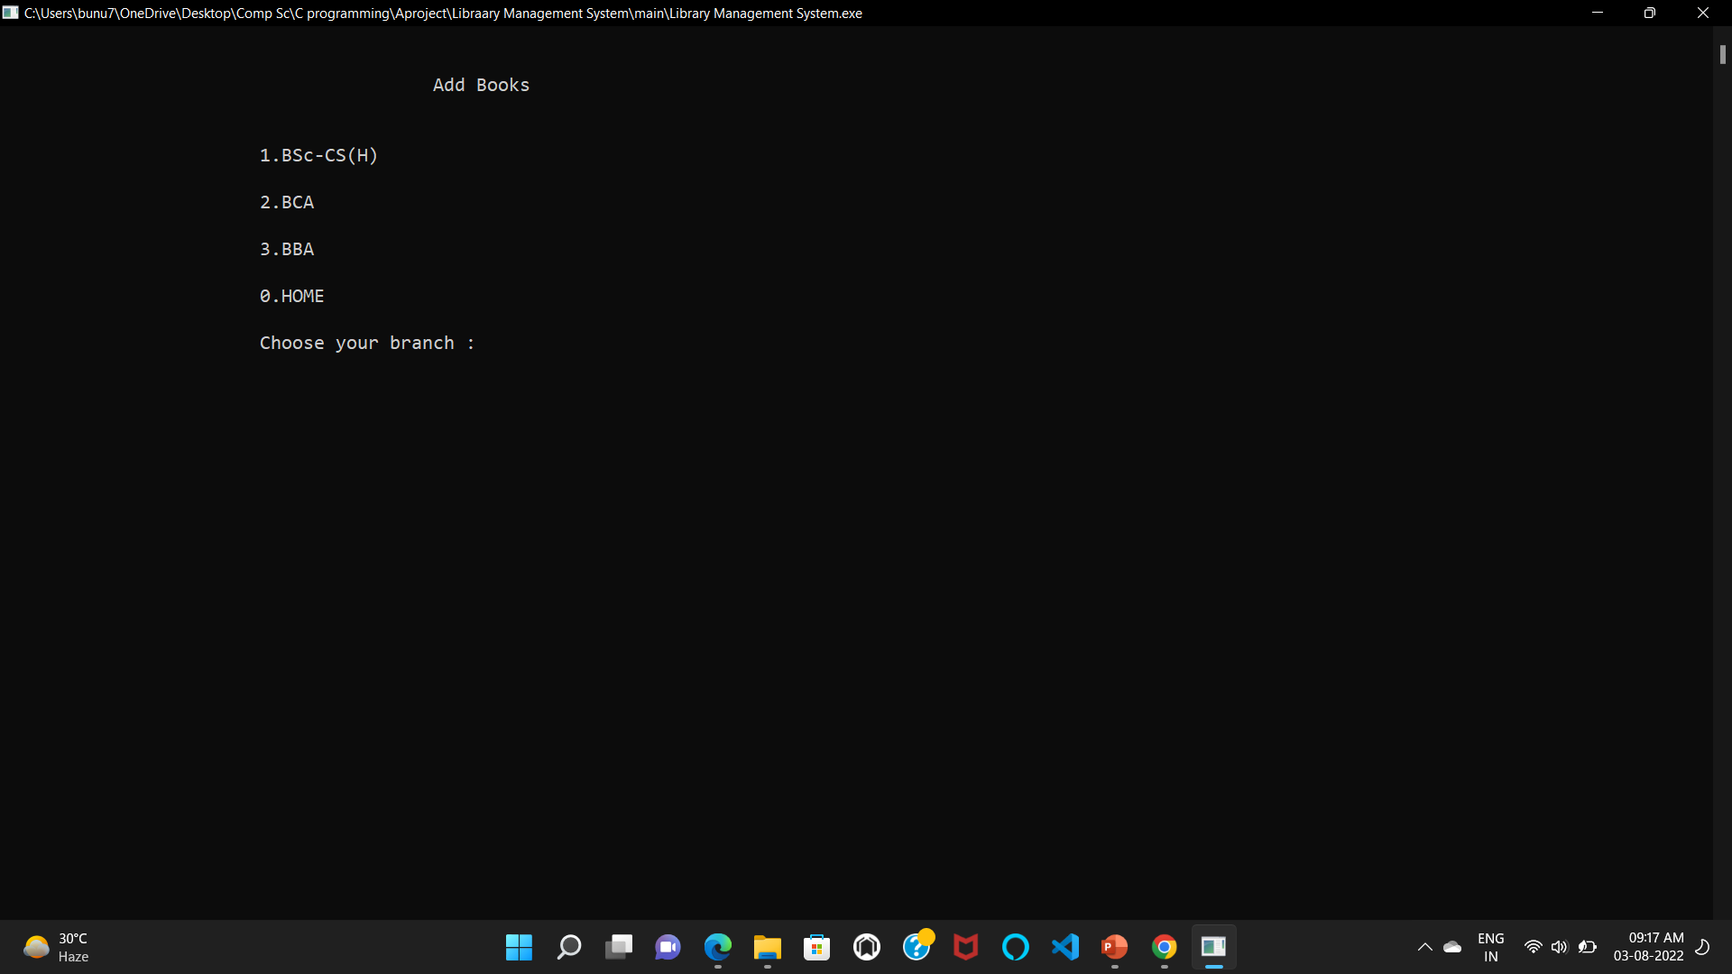
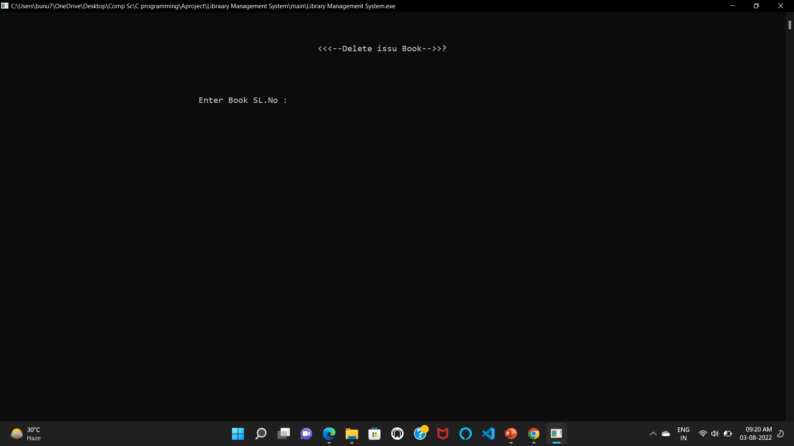
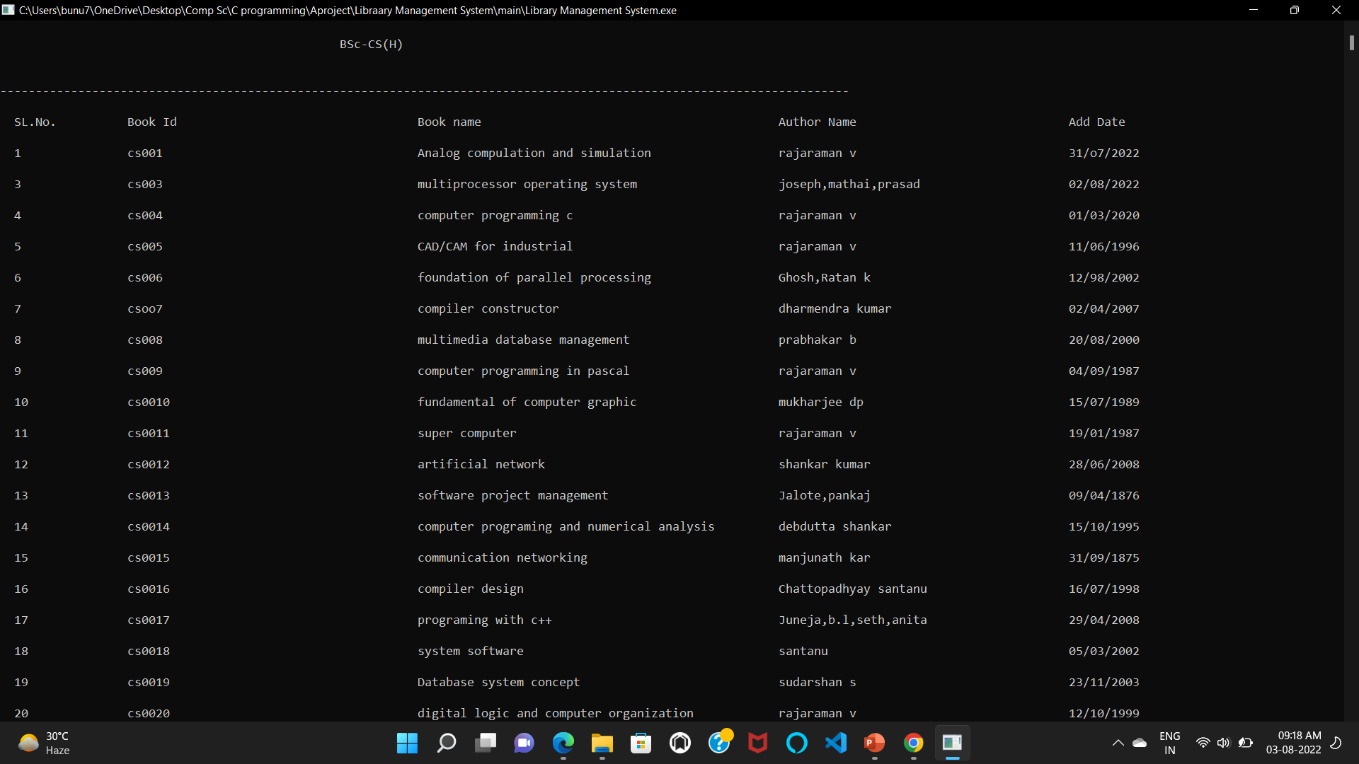

Slide 13
CONCLUSION :
The Library management system allows the user to store the book details and the person's details.
This software allows storing the details of all the data related to library.
The implementation of the system will reduce data entry time and provide readily calculated reports.

Slide 14

THANK YOU!

